Slide 1
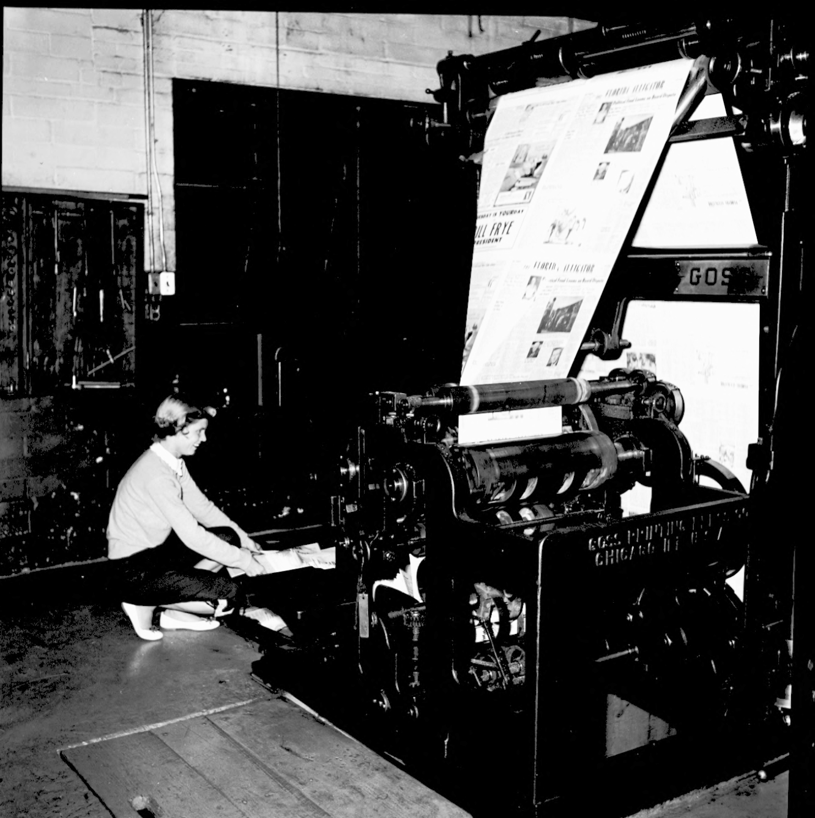

Enhancing Accessibility in Library Publishing
Challenges, Best Practices, & Sustainability
Valrie Minson, Tracy MacKay-Ratliff, & Kat Nguyen
University of Florida George A. Smathers Libraries
A woman lifts paper off the printing press at the University of Florida. 1950’s. https://ufdc.ufl.edu/uf00030852/00001

Slide 2






Agenda
1
Why Accessibility Matters
2
Recent Legislation
3
Understanding
responsibility
4
Tool & workflow recommendations
5
Our accessibility processes
6
Reflections & closing thoughts

Slide 3
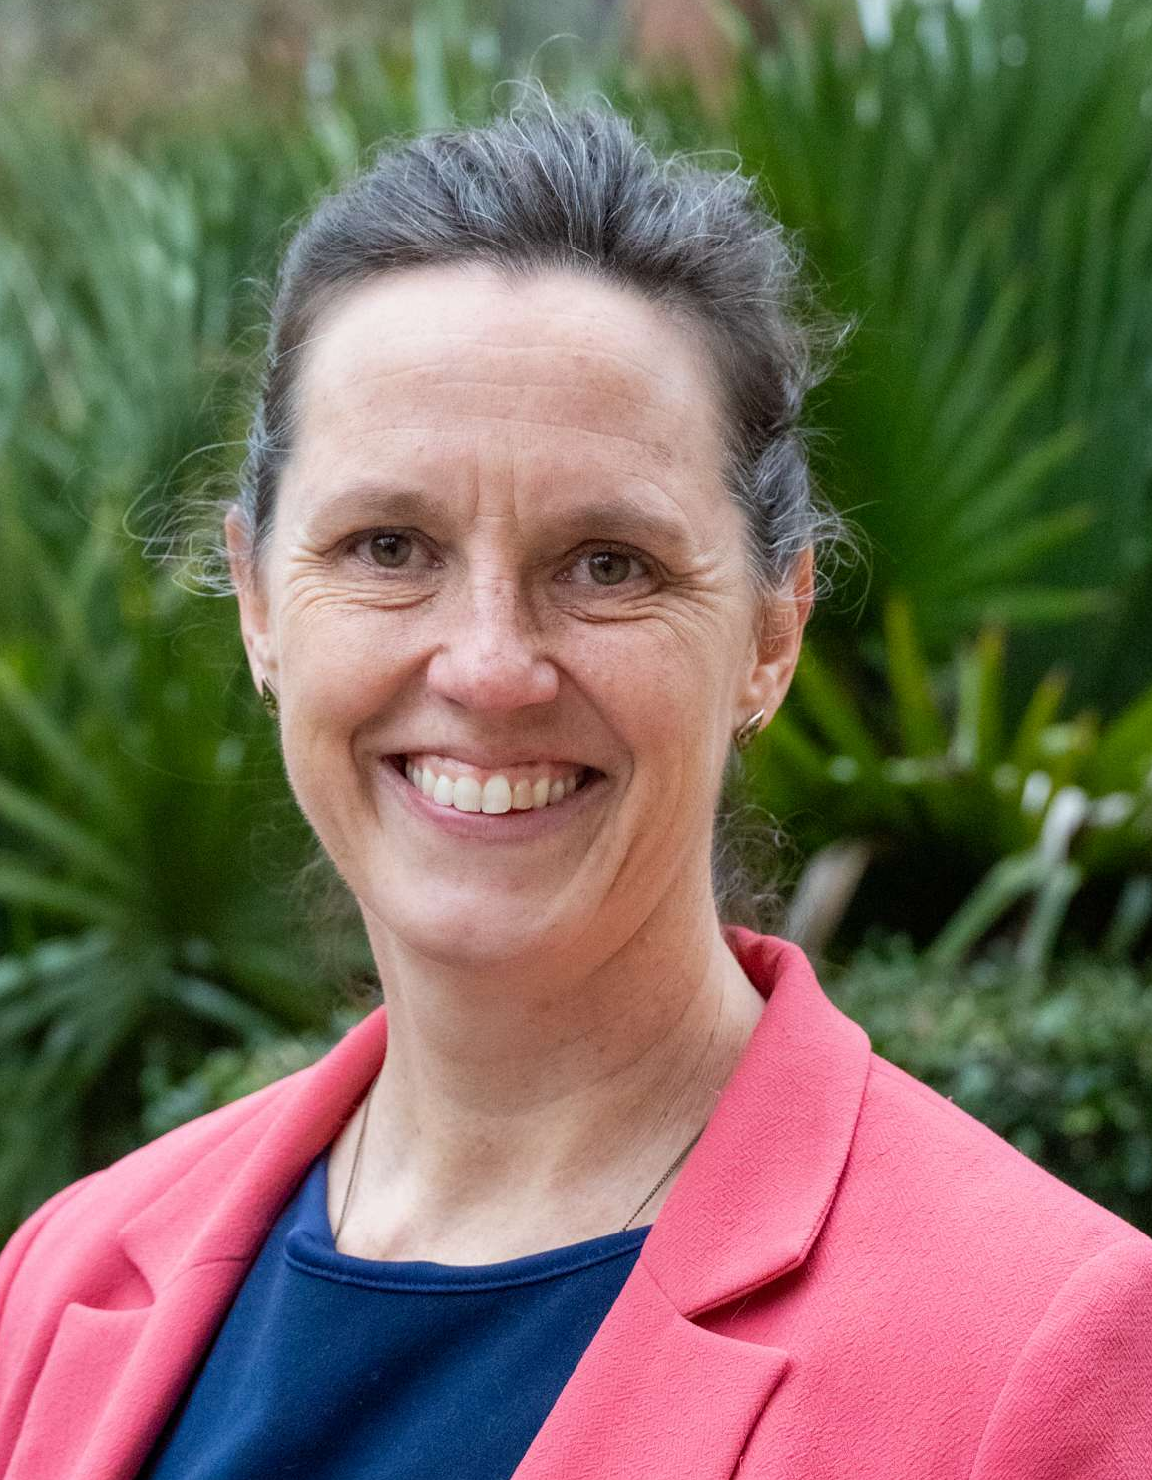
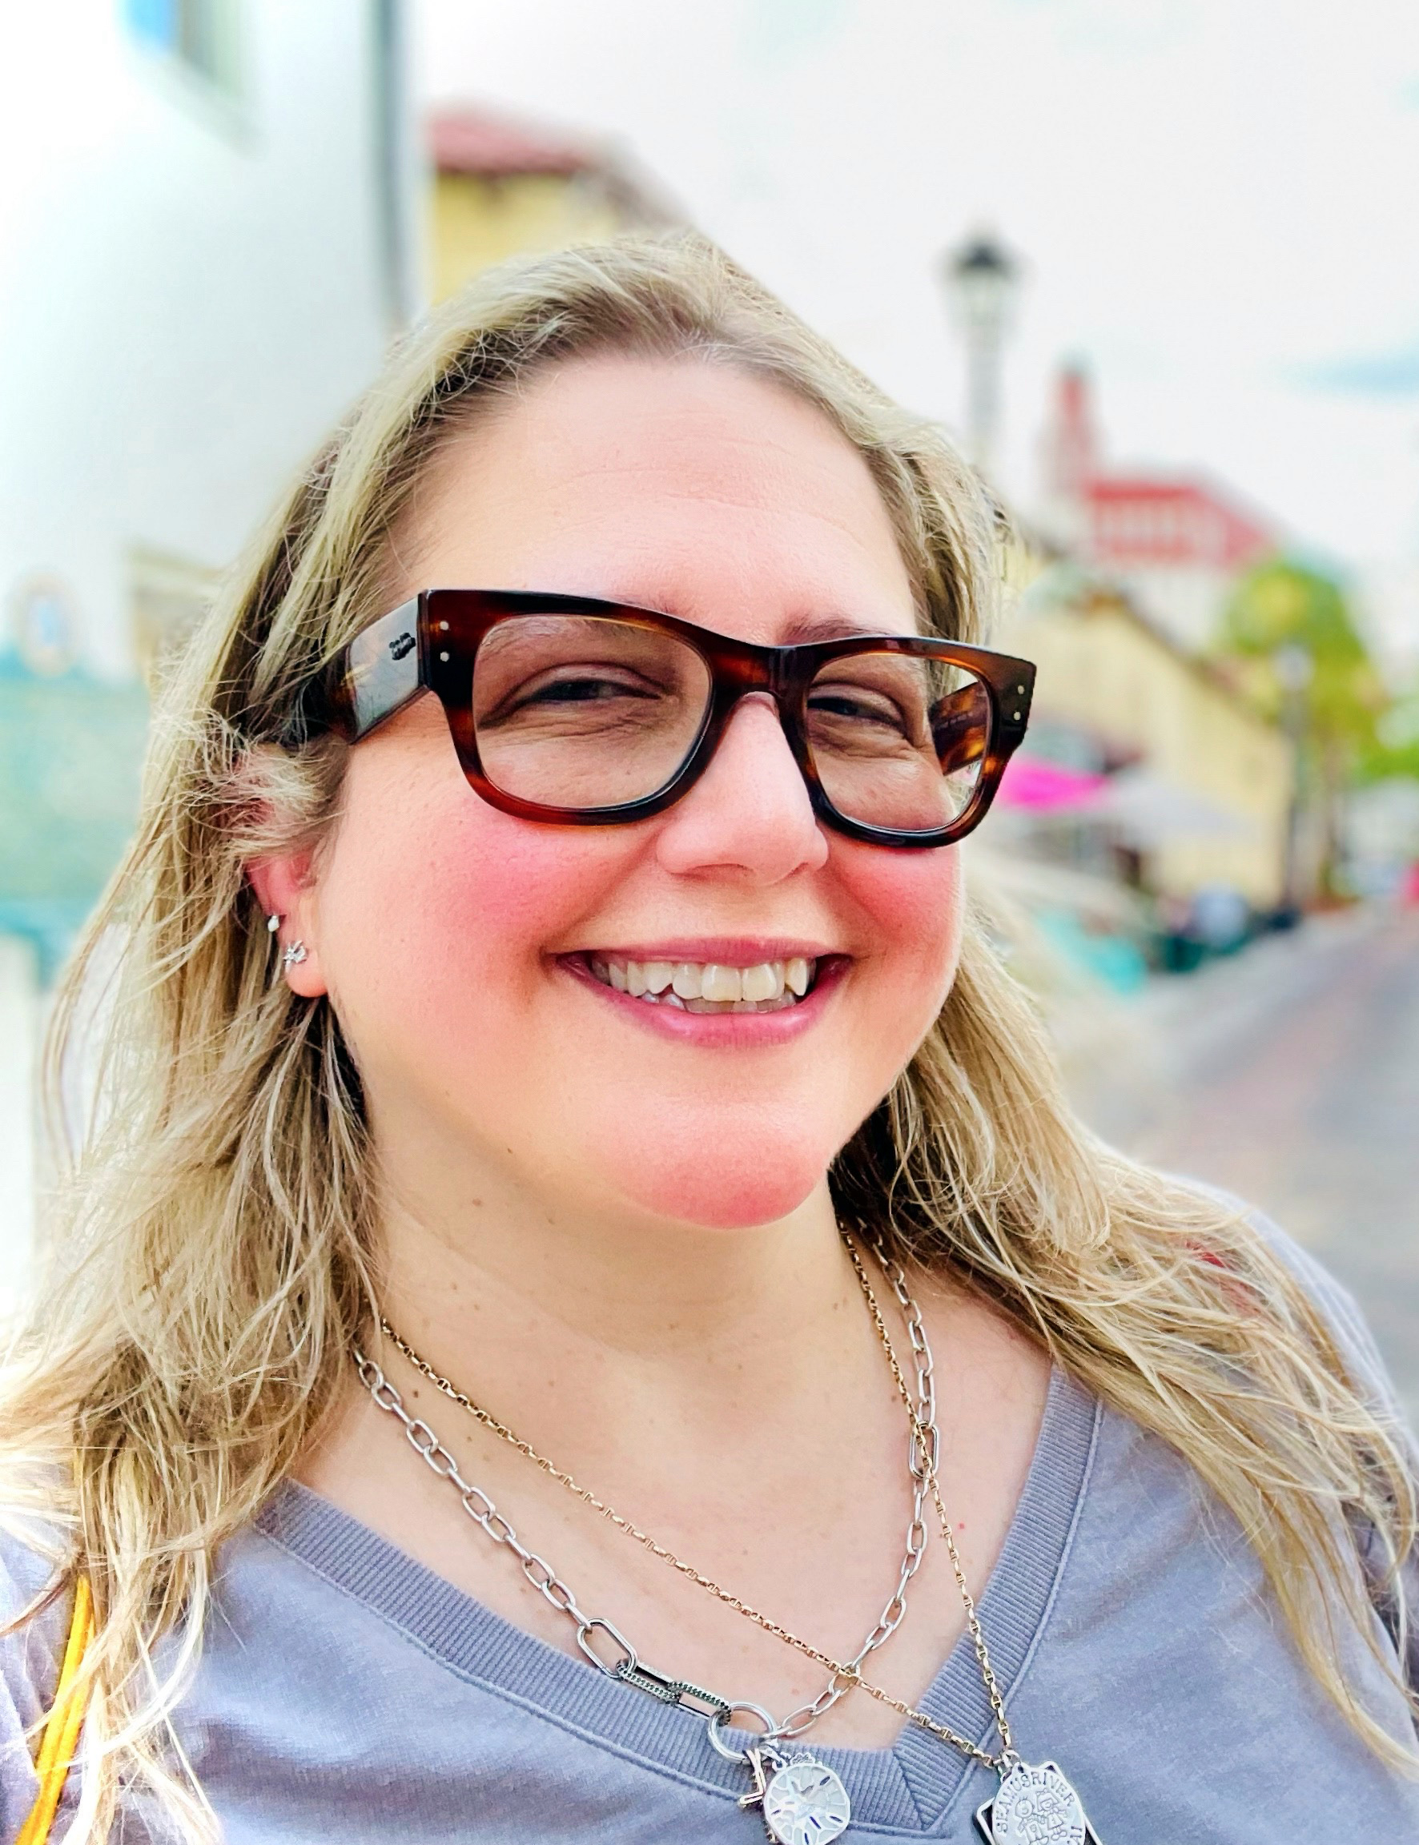

Meet LibraryPress@UF
Presenter
Co-Presenters
Valrie Minson
Kat Nguyen
Tracy
MacKay-Ratliff
Associate Dean of Research,
Smathers Libraries,
University of Florida
LibraryPress@UF
Publications Editorial Coordinator
Director of LibraryPress@UF

Slide 4

Mentimeter Question 1
Join us at menti.com
Use code
9642 8722
Notes:
Mentimeter Question 1

Slide 5



Why Accessibility Matters
Accessibility benefits everyone!
Libraries are leaders of open access and accessibility.
Accessibility of information is our responsibility.

Slide 6
Legislation & Laws

Slide 7
Title II regulations of the ADA Act of 1990
Provide a text equivalent for non-text content
Interactive elements can be operated with a keyboard or other assistive device, like a screen reader.
Accompany multimedia content, such as videos and audio files, with a transcript or other accessible format
Provide synchronized text and audio for multimedia content
Ensure that all digital materials are compatible with assistive technologies, like screen readers and braille displays.
Follow the Web Content Accessibility Guidelines (WCAG 2.1)

Slide 8
European Accessibility Act (EAA)
Passed 2019, implementation in 2025
The EAA sets out minimum accessibility requirements for products and services, including digital products and services. Specifically, e-book accessibility requirements include:
Must not prevent assistive technology from operating properly.
The content, navigation, and layout of e-books must be accessible, including allowing for dynamic layout.
Must provide synchronized text and audio and allow alternative renditions of content.
Provide flexibility and choice in presentation of content.
Provide information through metadata about their accessibility features.

Slide 9
Marrakesh Treaty to Facilitate Access to Published Works for Persons Who Are Blind, Visually Impaired, or Otherwise Print Disabled
Signed in 2013, ratified in 2016
To meet the requirements of the Marrakesh Treaty, publishers and creators must:
Make accessible versions available (through audiobooks, accessible e-book formats, or braille).
Limit copyright restrictions to allow for distribution of the accessible versions.
Facilitate distribution of accessible versions through organizations that specialize in providing accessible materials.

Slide 10
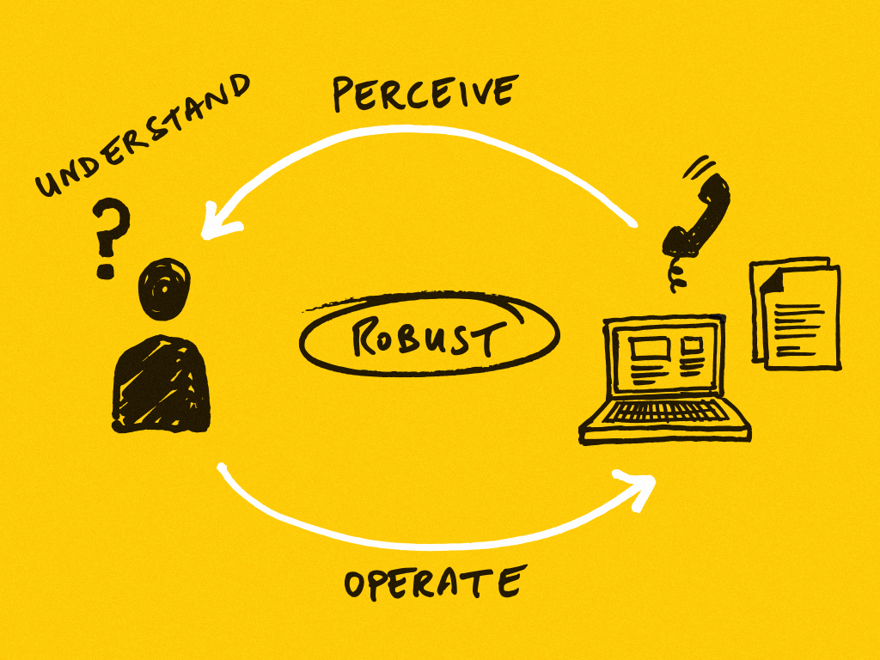
Web Content Accessibility Guidelines (WCAG 2.1)
POUR Principles of Accessibility
Perceivability: providing text equivalents, color contrast, and avoiding images of text
Operability: ensuring keyboard navigation and avoiding time limits
Understandability: providing clear and consistent navigation and labeling
Robustness: ensuring compatibility with assistive technologies

Slide 11

Universal Design

Slide 12
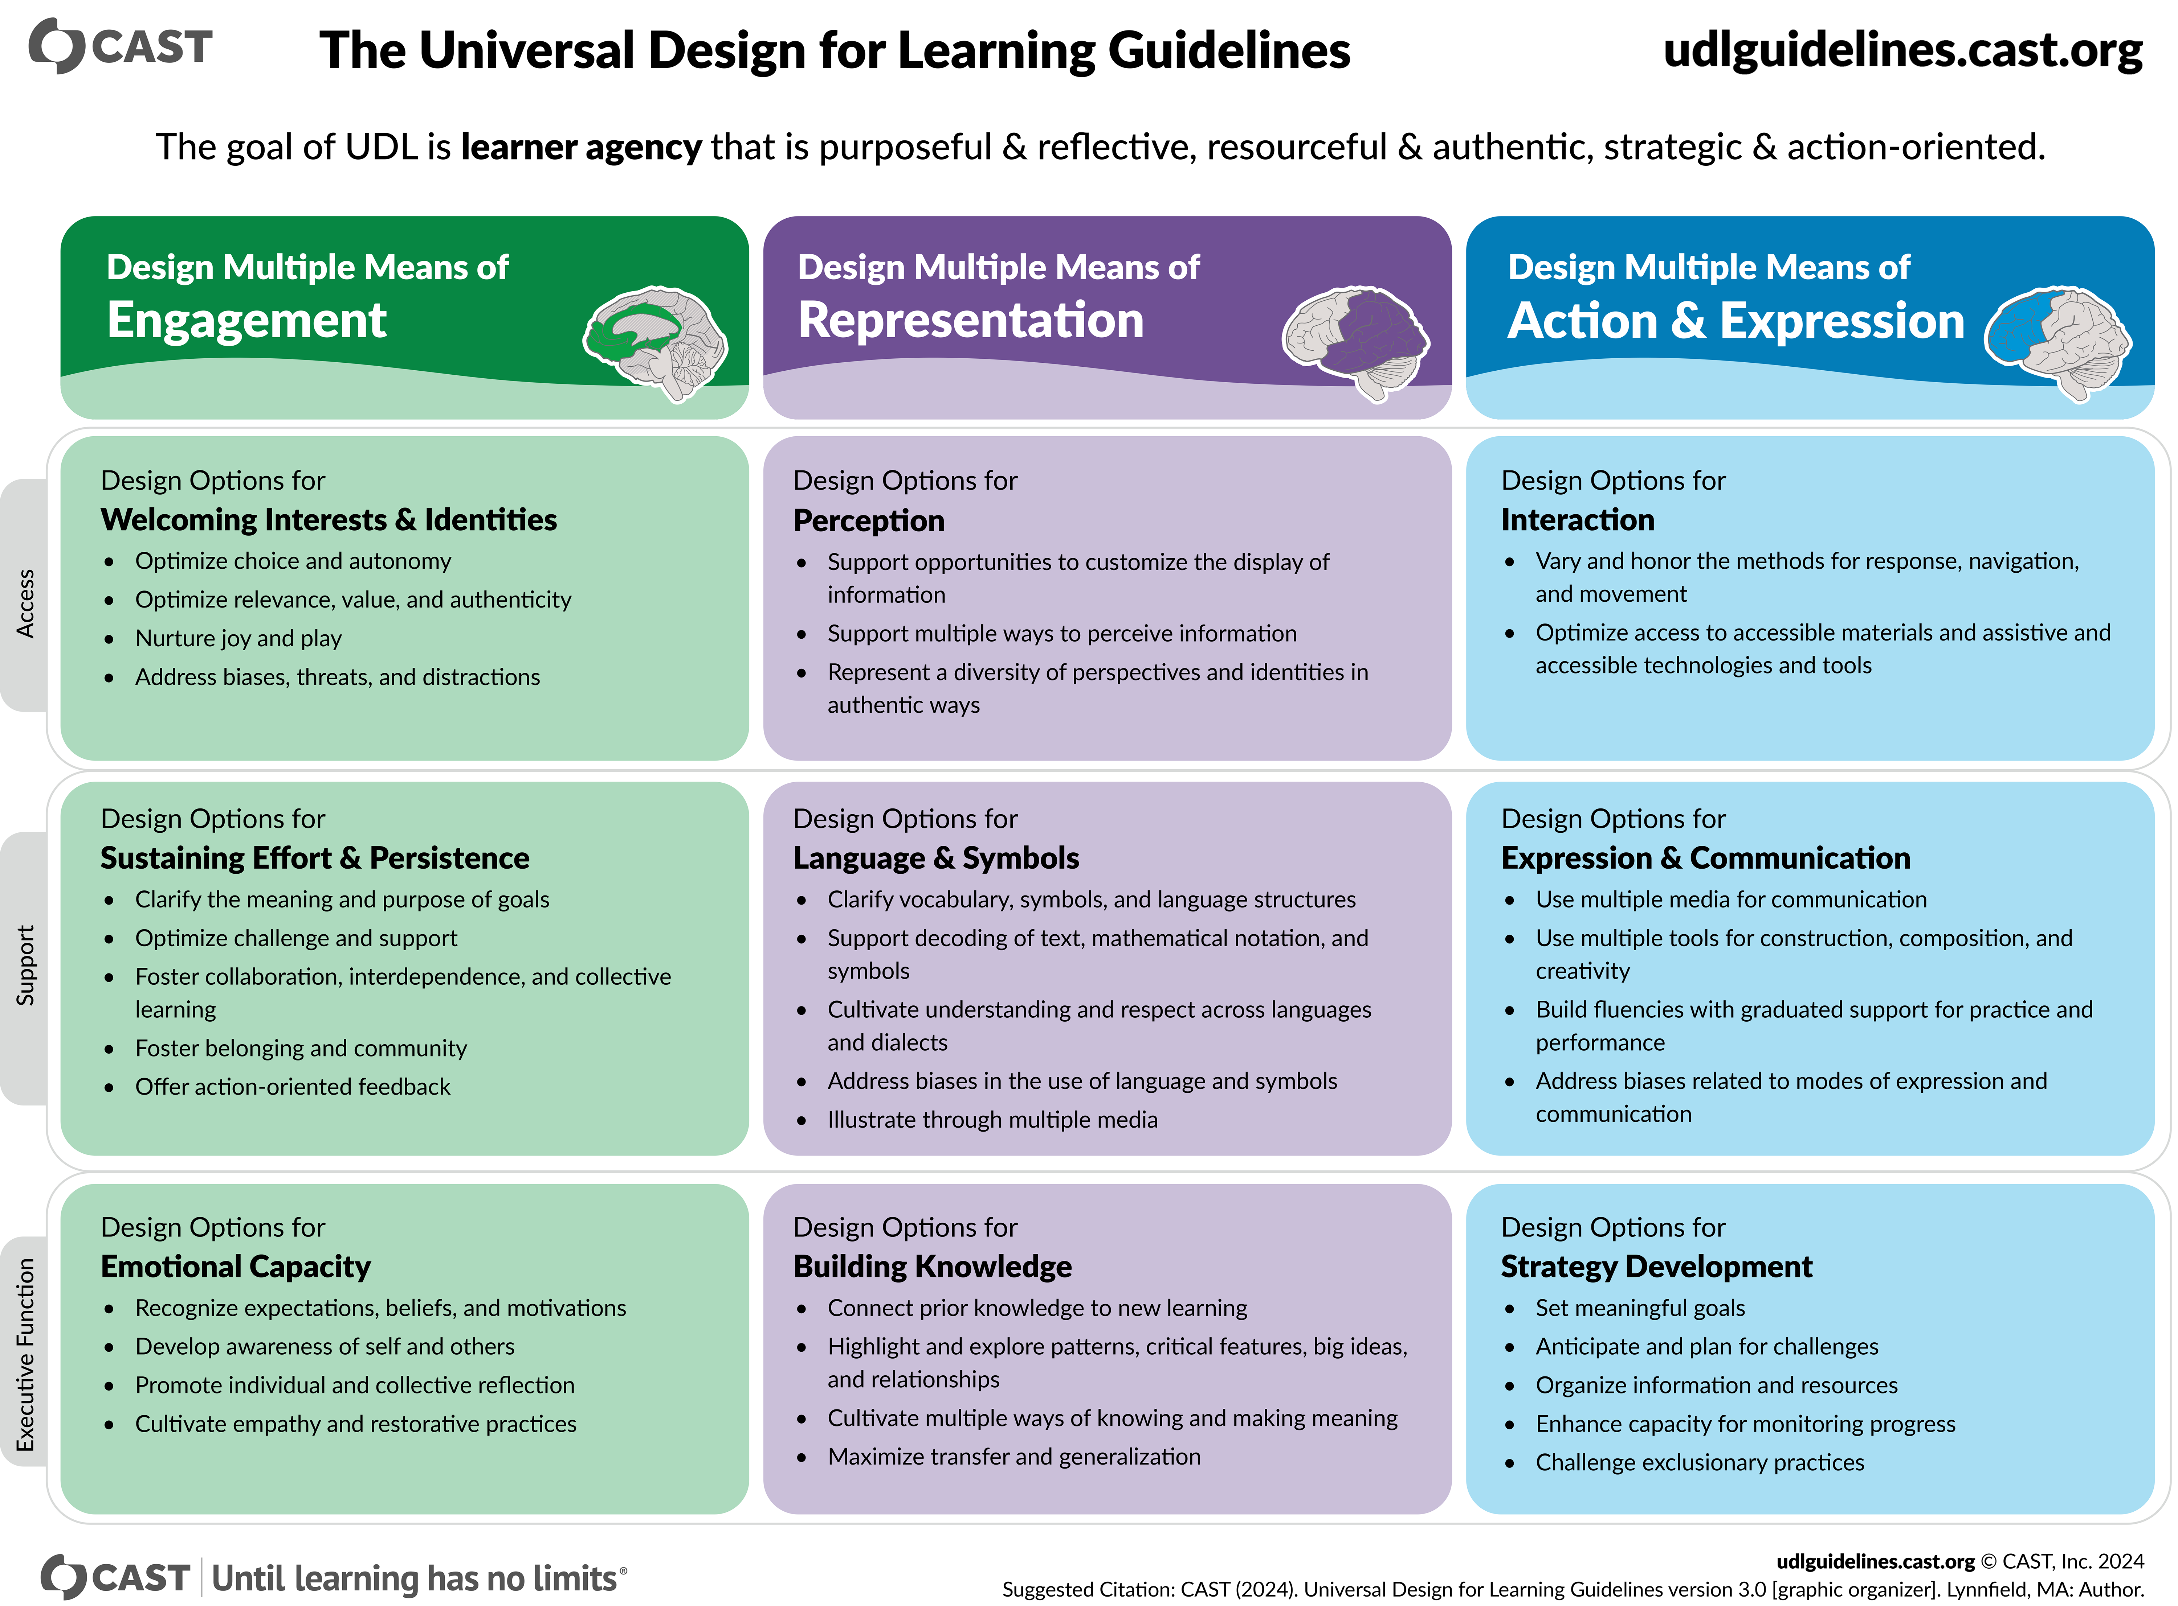

Slide 13
Mentimeter Question 2
Join us at menti.com
Use code
9642 8722
Notes:
Mentimeter Question 2

Slide 14
The “Shift Left” Approach: Accessibility from the Start
Thinking About Accessibility
Start conversations with authors early
Build accessibility into the publishing process
Accessibility is not a last-minute fix

Slide 15

Accessibility as Creativity
Thinking About Accessibility
How do you balance visual design with accessibility needs?
What creative approaches have you discovered?

Slide 16
Start with the Author
Building Accessibility into the Publishing Process
Involve authors early, as early as the MOU
Clearly articulate accessibility standards
  Include known issues or barriers
Provide source files that are easy to adapt
  Turn on accessibility checker!

Slide 17
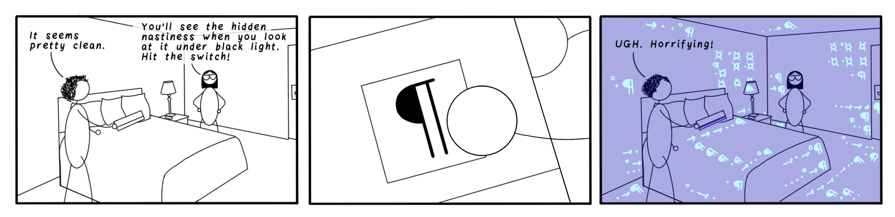
Understanding Responsibilities
The Life-Cycle of a Manuscript
Attribution: Iva Cheung
Author involvement in accessibility
Outlining expectations in MOUs/publication agreements

Slide 18
Mentimeter Question 3
Join us at menti.com
Use code
9642 8722
Notes:
Mentimeter Question 3

Slide 19
Initiatives & Challenges
OER Accessibility initiative with faculty
grants, stipends, or honorariums
Exploration of accessible PDFs and EPUBs
Accessible backlist conversions and remediation
Developing best practices for open - access books & journals

Slide 20
Strategies & Workflows
Utilize accessible publishing platforms
(e.g. WordPress, Scalar, Manifold, etc.)
Hire or train skillsets (experts and consultants)
or create committee/team
Accessibility audit and develop a plan
Develop policies
Create author guides, provide consultations,
etc.
Utilize accessibility tools (e.g., DAISY)
Refresh and evaluate efforts

Slide 21






Resources & Community
Resources
Community
Librarypress.domains.
uflib.ufl.edu/accessibility/

Slide 22
Mentimeter Question 4
Join us at menti.com
Use code
9642 8722
Notes:
Mentimeter Question 4

Slide 23
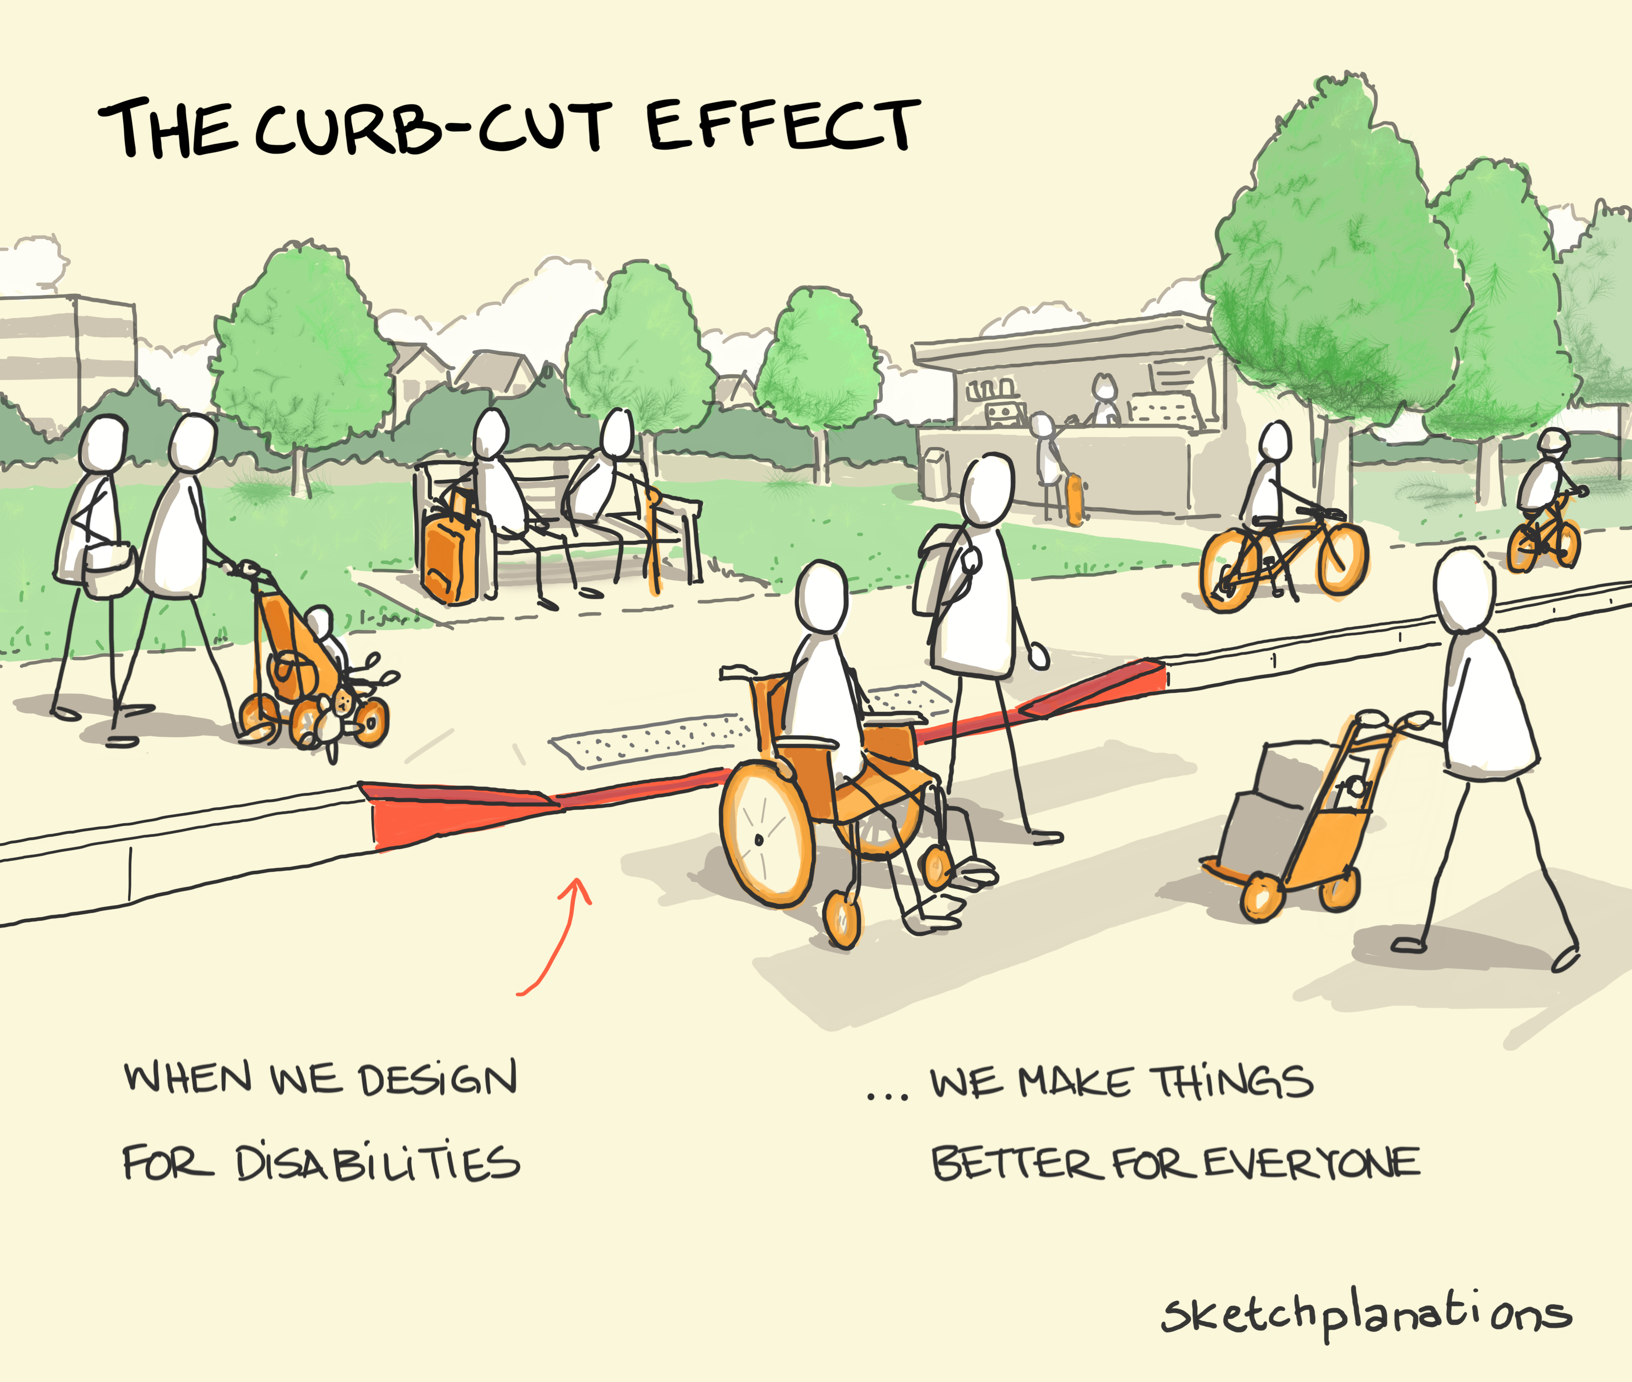
Reflections & Closing Thoughts
Accessibility doesn’t need to be overwhelming. Start with what you can do!
How will you start implementing accessibility into your workflow?
Keep the accessibility conversation going!

Slide 24


Questions?
Thank You!
go.ufl.edu/librarypress
librarypress@uflib.ufl.edu
Notes:
LP@UF Accessibility Presentation Slides: https://2025librarypublishingforum.sched.com/event/21BOS
LP@UF Accessibility Page with Resources (always evolving thanks to our amazing library publishing community): https://librarypress.domains.uflib.ufl.edu/accessibility/

Slide 25
Resources
United States Department of Justice. (2010). Title II Regulations - Implementing the Americans with Disabilities Act. Retrieved from https://www.ada.gov/law-and-regs/regulations/title-ii-2010-regulations/
European Commission. (2021). European Accessibility Act. Retrieved from https://commission.europa.eu/strategy-and-policy/policies/justice-and-fundamental-rights/disability/union-equality-strategy-rights-persons-disabilities-2021-2030/european-accessibility-act_en
World Trade Organization. (2013). Marrakesh Treaty to Facilitate Access to Published Works for Persons Who Are Blind, Visually Impaired, or Otherwise Print Disabled. Retrieved from https://www.wipo.int/treaties/en/ip/marrakesh/
CAST. (2018). Universal Design for Learning Guidelines version 2.2. Retrieved from https://udlguidelines.cast.org/
World Wide Web Consortium. (2021). Web Content Accessibility Guidelines (WCAG) 2.1. Retrieved from https://www.w3.org/TR/WCAG21/
https://internationalpublishers.org/the-european-accessibility-act-for-non-eu-members/
Accessibility as Creativity image. Attribution: Pablo Busatto - https://commons.wikimedia.org/wiki/File:Accessibility_logo.svg
Vectors image. Attribution: <a href="https://www.vecteezy.com/free-vector/monitor">Monitor Vectors by Vecteezy</a>
Lifecycle of a Manuscript. Iva Cheung - https://laurabrady.ca/blog/accessibility-and-editorial
LibraryPress@UF. Librarypress.domains.uflib.ufl.edu/accessibility/
Curb-cut. Image: Jono Hey, sketchplanations.com - Creative Commons Attribution-NonCommercial 4.0 International License

